Slide 1

The Next Adventure
Data Science Capstone Project
By Sriharsha Jayanti
March 28, 2020

Slide 2

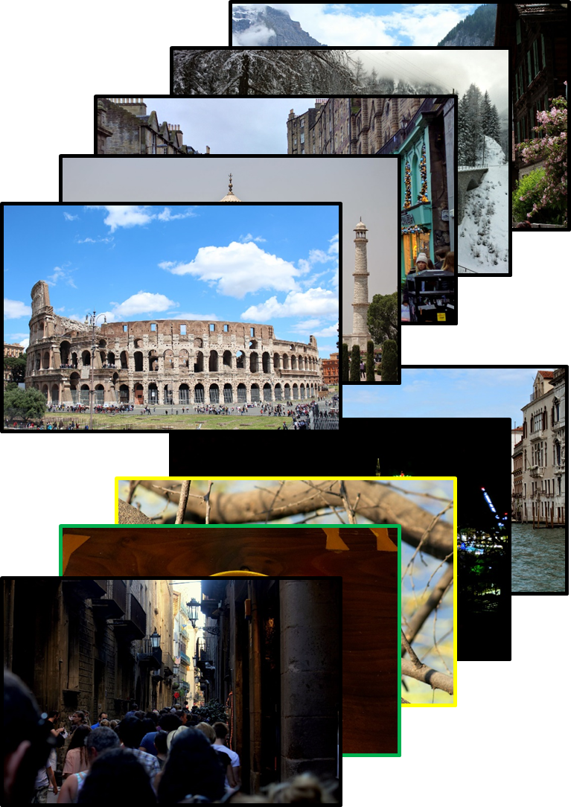
Business Problem and Scope
How can we help a person choose their next adventure?
Full scale of this problem can be quite challenging
To narrow scope, only capital cities in each country included in this study
Potential factors in choosing the destination:
Preference: Nature, Food Scene, Nightlife, Historic Significance, Cultural Diversity
Similarities to or differences from previous travels
Knowledge of options: Not knowing all options or having too many options
Price and accessibility
Simplified Business Problem:
Develop a starting point for recommending destinations across the world based on a person’s venue preference and past history

Slide 3
Data Collection and Assumptions
Data sources:
Table of capitals from Wikipedia (https://en.wikipedia.org/wiki/List_of_national_capitals)
Geopy to obtain latitude and longitude
Foursquare API venue data
Price and accessibility: Will not be included for this study (Premium API endpoint on Foursquare)
Assumptions
Capital city of a country is representing the country. This is a big generalization
Data availability for each of the capital cities is accurately representing the city. May not be true if the Foursquare data is not exhaustive

Slide 4
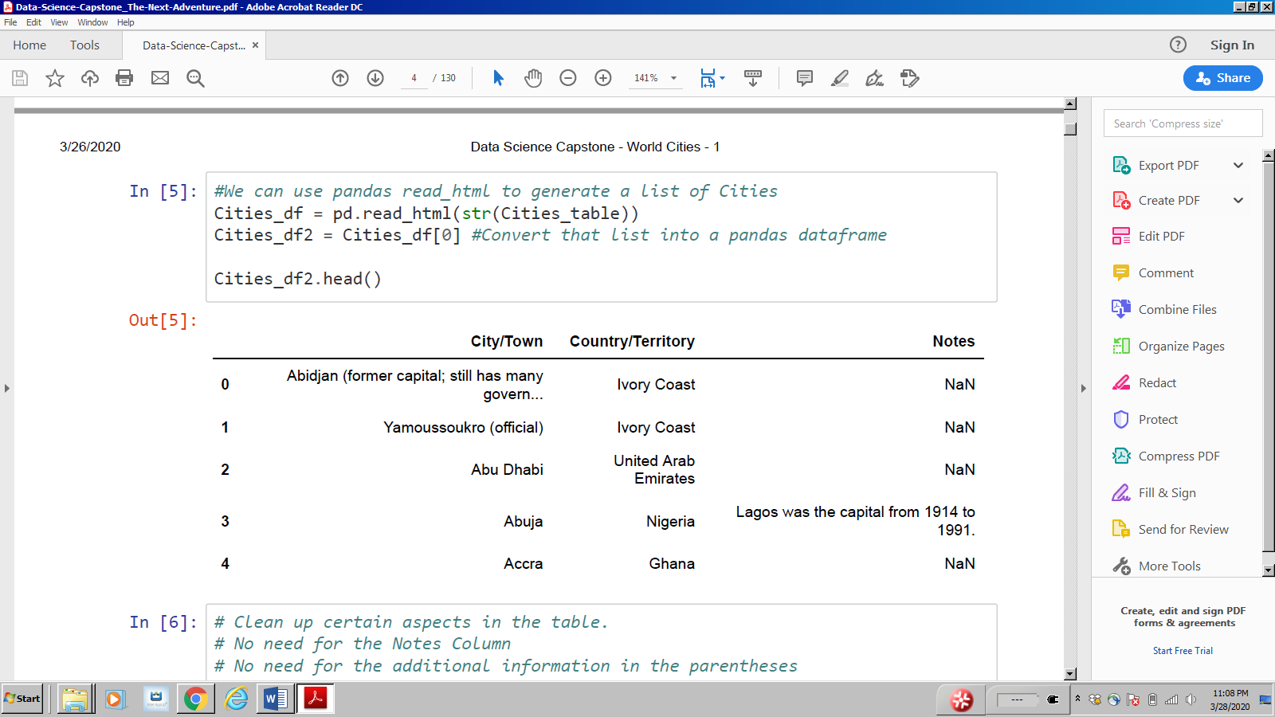
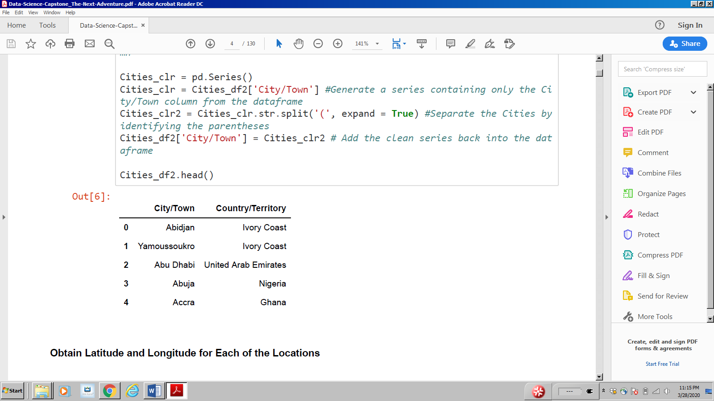
Methodology –Table with Countries and Capitals
BeautifulSoup4 used to scrape table from Wikipedia
Data clean up
Remove information in parentheses in City/Town column
Drop Notes Column
Table 1: Capitals and Countries Scraped From Wikipedia
Table 2: Capitals and Countries Cleaned Up
Clean up

Slide 5
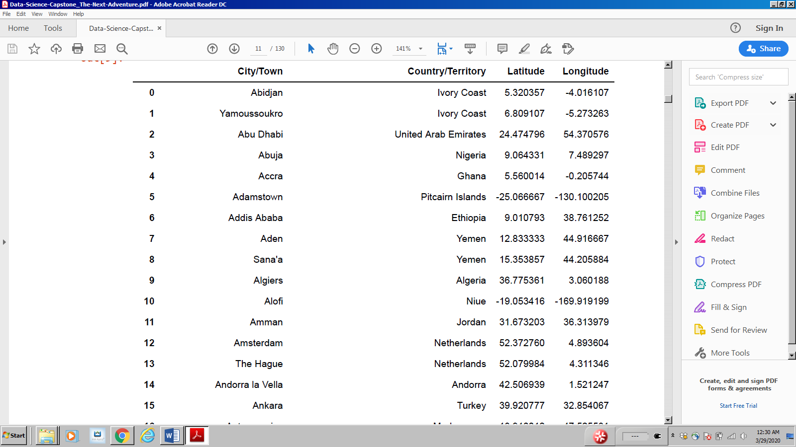
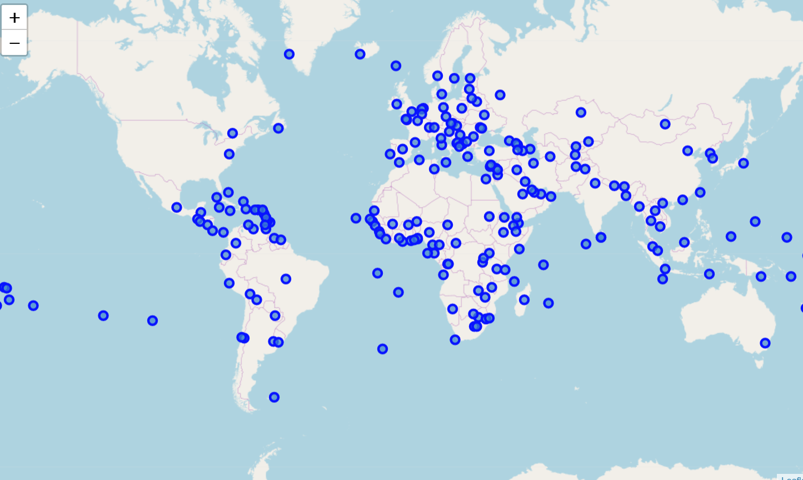
Methodology – Adding Coordinate Data
Geopy used to obtain coordinate data
Some entries missing due to unavailability
Map shows markers at the correct location
Validates data collection so far
Table 3: Latitude and Longitude Information
Figure 1: Map Showing all Capital Cities

Slide 6

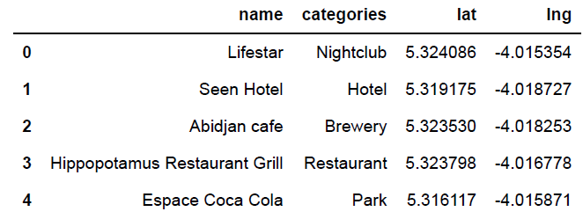
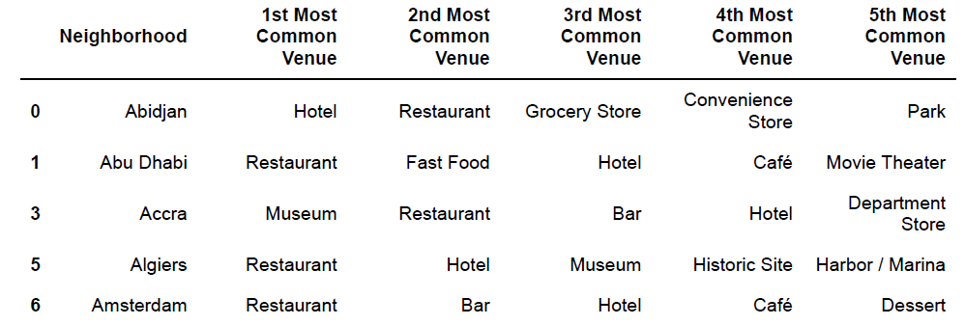
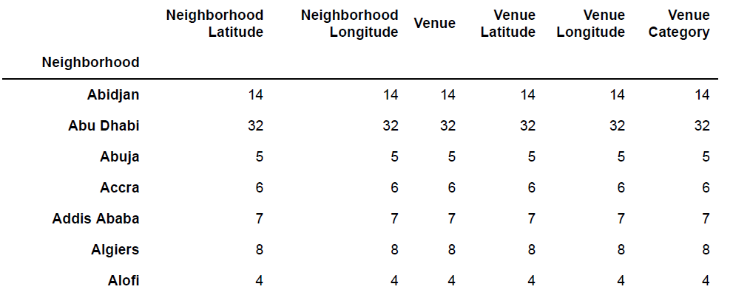
Methodology – Generating Venue Data
Objective: generate table with top 5 venues for each city
Foursquare API use to obtain venue data
Consolidated number of categories to <200 from >400 (example: different cuisines of restaurants combined into restaurants)
Dropped cities with less than 5 different venues → total number of cities reduced from >250 to ~130
Table 3: Latitude and Longitude Information
Table 4: Example, Venue Data for Abidjan
Foursquare API
Groupby Function
Table 6: Table with Most Common Venues
Table 5: Number of Venues for Each City
Data Clean Up/ Analyze Venue categories

Slide 7
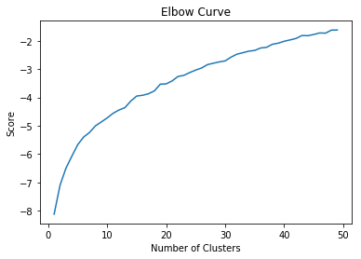
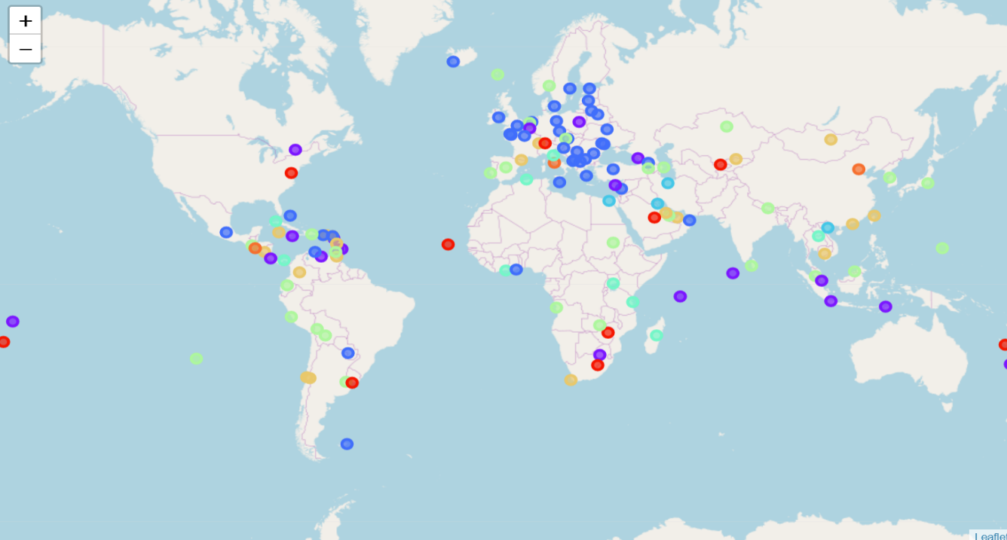
Methodology – Kmeans Clustering of the Cities
Number of clusters determined by Elbow Method (subjective)
A fit of accuracy vs number of clusters
Number of clusters scanned from 1 to 50
Score determine for each number of clusters using kmeans.fit.score
Elbow appears to be around 8 clusters
Figure 2: Optimal Number of Clusters is 8
Figure 3: World Map Clustered Using Kmeans

Slide 8
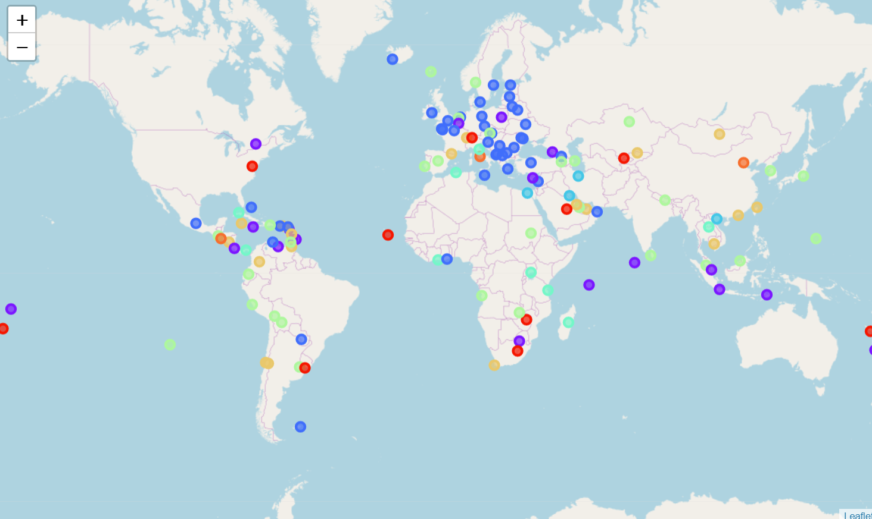
Results – Map of Cities (Clustered using Kmeans)
Figure 3: World Map Clustered Using Kmeans
Capital cities clustered into 8 groups
Numerous countries/cities missing due to lack of sufficient information
Most European cities in Cluster 2
Cluster 2 details
Marker color: Blue
Common categories:
Restaurants
Bars
Café
Desserts
Hotels
Museum
Fast Food
…

Slide 9
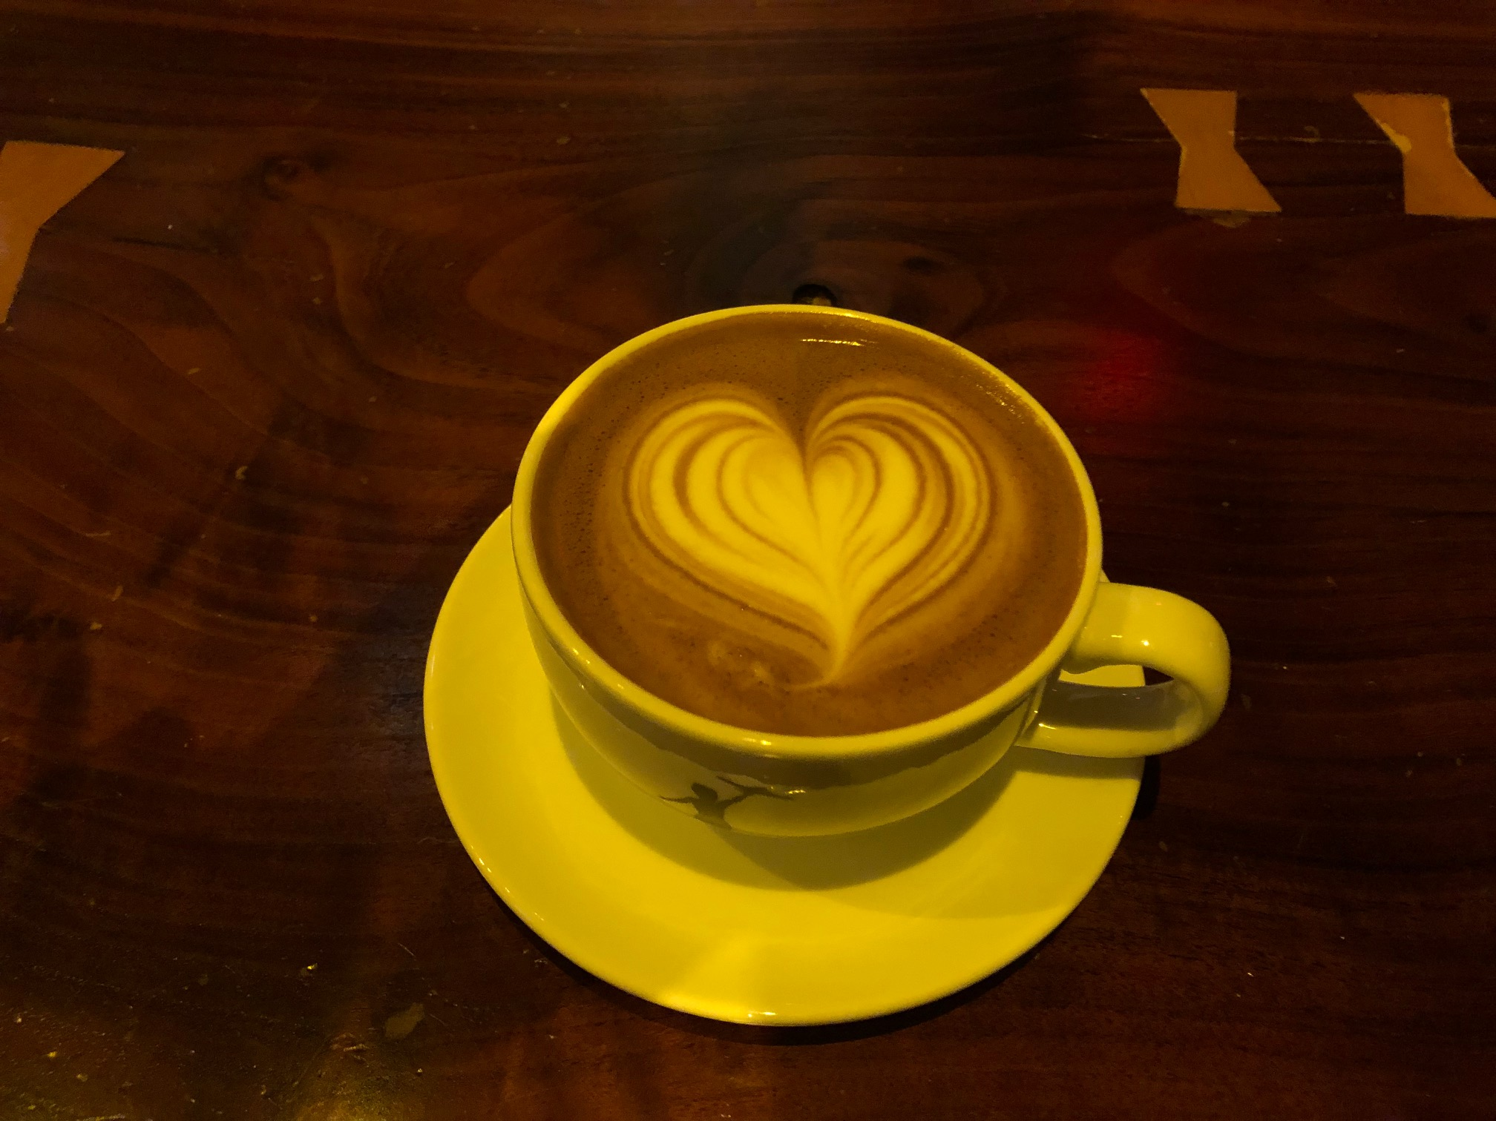
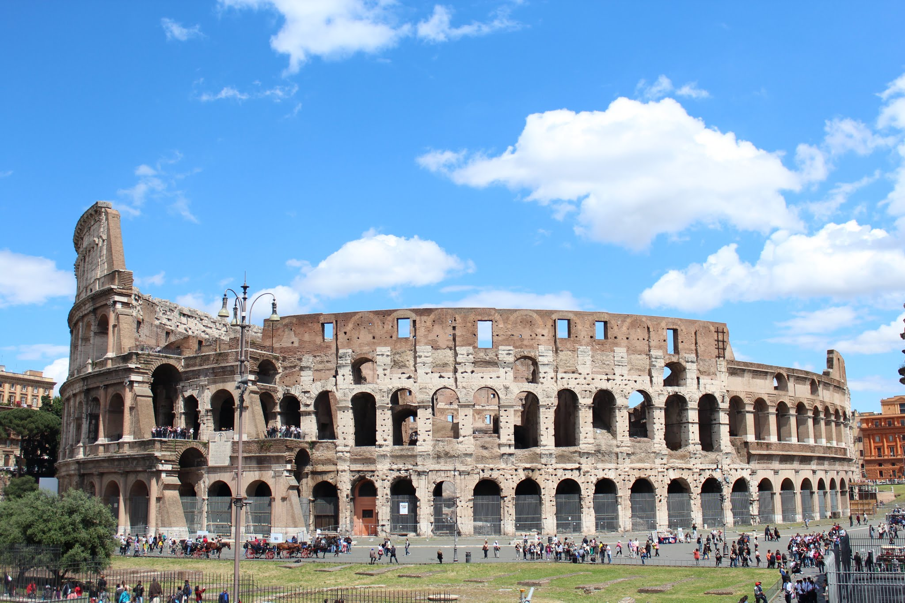
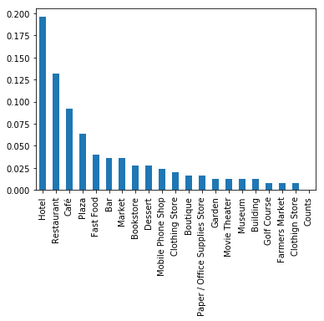
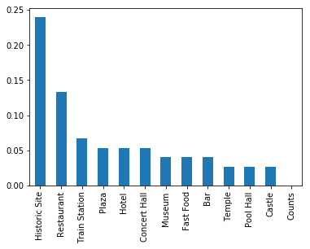
Results – Cluster 0 vs Cluster 7 Deeper Look (Example)
Cluster 0
Marker color: Red
Countries: Zimbabwe, Lesotho, Uruguay, New Caledonia, Tonga, Cape Verde, Saudi Arabia, Uzbekistan, Liechtenstein, and United States
Cluster 7
Marker color: Orange
Countries: China, Italy, El Salvador
Figure 4: Cluster 0 Most Common Venue Categories
Figure 5: Cluster 7 Most Common Venue Categories

Slide 10
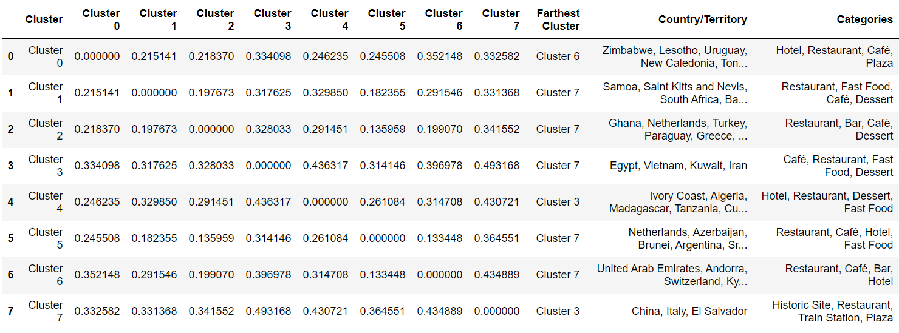
Results – Summary Table
Summary Table
Venue categories in each cluster
Countries in each cluster
Similarities between clusters (Euclidean distance between each pair of clusters)
Most different cluster (farthest cluster) to show the cluster of cities that are least like those in the original cluster
Table 7: Summary Table Showing Cluster, Country, Common Categories, Euclidean Distances to Other Clusters, and Most Dissimilar Cluster of Countries

Slide 11
Discussion and Takeaways
Map and Summary table address the business problem
Roughly half the capitals clustered into 8 groups (visible at a glance on the map)
Cities clustered using most common venues based on Foursquare API
Many of the most common categories similar between all clusters
Hotels, Restaurants, Café, Bar, Dessert and Fast Food appear as top 3 most common venues in all but one of the clusters (cluster 7)
Euclidean distances enable us to choose destination based on similarities to or differences form past travels
Limitations
Significant number of places missing in Africa and Asia
Tradeoff between number of venue categories and number of venues
Many places had less than 10 venues and less then 5 venue categories
To look at more than 5 venue categories, we would need to drop more cities from analysis
To look at more location, we would need to consider fewer categories → but then the clustering will be less meaningful

Slide 12
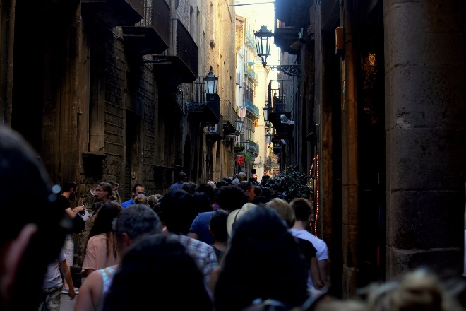
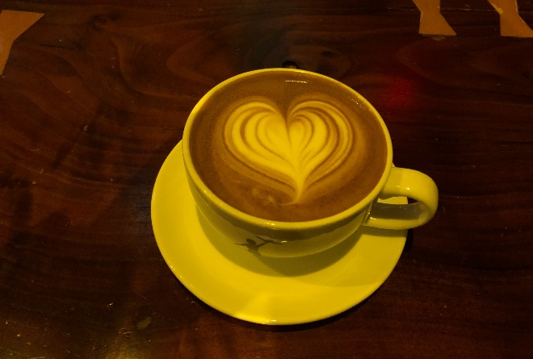

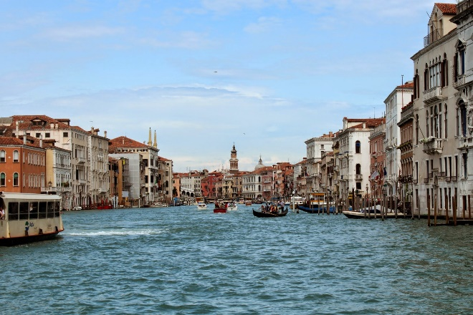
Conclusion/Future Outlook
This study a starting point
Ideas for further improvement
Multilevel indexing for categories (start with fewer broad categories, 10-20) with subcategories
Replace most common venues with most popular venues (based on ratings/reviews)
Add more cities around the world
Combine data from additional sources, not just Foursquare
(2000)
(100)
(800)
(800)

